Slide 1
Logistic Regression
Amir Ali

Slide 2
First-Time Home Buyer
As a first-time home buyer, you are busy organizing your financial records so you can apply for a home mortgage. As part of this process, you order a copy of your credit report to check for errors and gauge your credit score, ranging from 300 to 850. Lenders will factor in your credit score when deciding to approve or not approve you for a mortgage. It turns out your score is 720.
While doing your research, you find some raw data online showing 1000 applicant credit scores and whether or not the application was approved (yes/no).

Slide 3
First-Time Home Buyer
Using the data you found, you would like to do the following:
Develop a model that will provide the probability and the odds of being approved for any given credit score.
Discover approximately what credit score is associated with a probability is 50% (the odds are even) of being approved.
Input your score of 720 into the model to determine the probability and odds of you being approved for a mortgage.
Determine how improving your credit score from 720 to 750 would affect your probability and odds of being approved for the mortgage.

Slide 4
Model Data
creditScore | approved
655 | 0
681 | 0
663 | 1
688 | 1
693 | 1
699 | 0
699 | 1
683 | 1
698 | 0
655 | 1
703 | 0
704 | 1
745 | 1
702 | 1
n = 1000
creditScore is the applicant’s credit score
approved is coded “1” is approved and “0” is not proved (Binary).
* Only 14 of 1000 observations shown

Slide 5
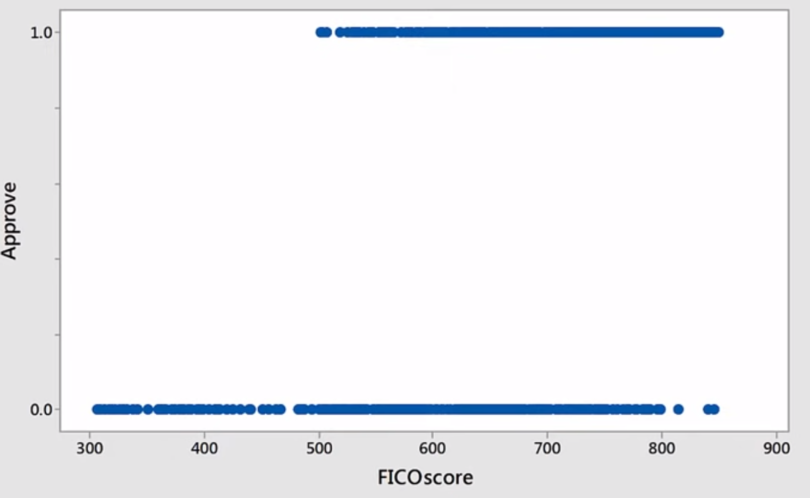
Scatterplot of Approve vs FICOscore
?
Strange scatterplot!
Best-fit line

Slide 6
What is Logistic Regression
Logistic regression seeks to:
model the probability of an event occurring depending on the values of the independent variables, which can be categorical or numerical
estimate the probability that an event occurs for a randomly selected observation versus the probability that the event does not occur
predict the effect of a series of variables on a binary response variable
classify observations by estimating the probability that an observation is in a particular category (such as approved or not approved in our problem)

Slide 7
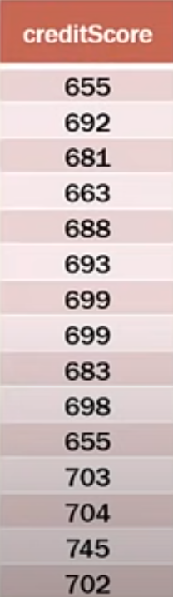
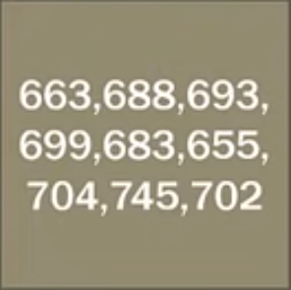

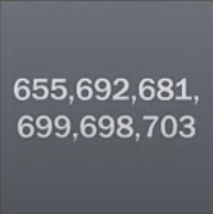
Understanding the Process
Approved
Not Approved
What is the probability that an application with a score of 670 would be approved?

Slide 8
Why Not Other Regression Methods?
Why other regression procedures will not work:
Simple linear regression is one quantitative variable predicting another
Multiple regression is a simple linear regression with more independent variables
Nonlinear regression is still two quantitative variables, but the data is curvilinear.
Running a typical linear regression, in the same way, has major problems:
Binary data does not have a normal distribution, which is a condition needed for most other types of regression
Predicted values of the DV can be beyond 0 and 1 which violates the definition of probability

Slide 9

Probability Review
P = $\frac{Outcomeof Interest }{All possible outcomes}$
Example: fair coin flip
P(heads) = $\frac{1}{2}$ = 0.5

Slide 10

What are The ODDS
odds = $\frac{P(occurring) }{q(not occurring)}$
odds = $\frac{P }{1−p}$
Example: fair coin flip
odds(heads) = $\frac{0.5}{0.5}$ = 1 or 1:1

Slide 11
ODDS Ratio
The odds ratio is exactly what it says it is, a ratio of two odds
Fair coin flip
P(heads) = 1/2 = 0.5
Odds(heads) = 0.5 / 0.5 = 1 or 1:1
Loaded coin flip
P(heads) = 7/10 = 0.7
Odds(heads) = 0.7/0.3 = 2.333
Odds ratio = odds1 / odds0
Odds ratio = 2.333 / 1
Odds ratio = 2.333
The odds of getting “heads” on the loaded coin are 2.333x greater than the fair coin

Slide 12
ODDS Ratio in Logistic Regression
The odds ratio for a variable in logistic regression represents how the odds change with a 1 unit increase in that variable holding all other variables constant
For (fictitious) example:
Body weight and sleep apnea (two categories: apnea / no apnea)
Weight variable had an odds ratio of 1.07
This means a one-pound increase in weight increases the odds of having sleep apnea by 1.07 (not very high b/c we are looking at 1Ib increments)
A ten-pound increase in weight increases the odds to 1.98 or almost doubles a person's odds of having sleep apnea, and a 20 pound increases or having raises the odds to 3.87 or almost 4x greater
This holds true at any point in the weight spectrum.

Slide 13
A Warning
It is essential to separate probability and odds
In the previous example, a person gaining 20 pounds increases their odds of sleep apnea by almost a factor of 4 regardless of their starting weight
However, the probability of having apnea is LOWER in people with lower body weight, to begin with.
So, while the odds are 4x greater, the probability may still below
Basically, what this means is that the odds can have a large magnitude even if the underlying probabilities are low

Slide 14
Bringing Back Bernoulli
The dependent variable in logistic regression follows the Bernoulli distribution having an unknown probability, p
Remember that the Bernoulli distribution is just a special case of the Binomial distribution where it = 1 (just one trial)
Success is "1" and failure is "0"
So the probability of success is p and failure is q = 1 — p.
In logistic regression, we are estimating an unknown p for any given linear combination of the independent variables
Therefore, we need to link together our independent variables to essentially the Bernoulli distribution; that link is called the logit.

Slide 15
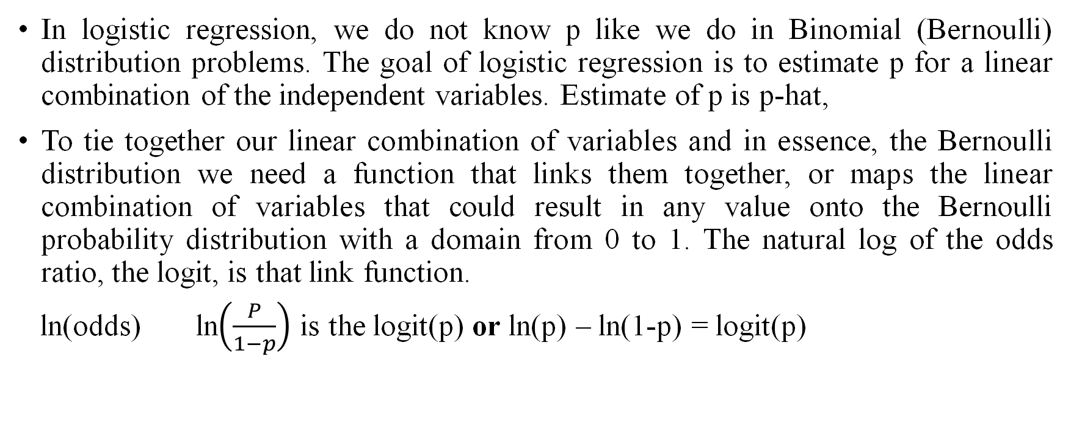
What is the Logit?
In logistic regression, we do not know p like we do in Binomial (Bernoulli) distribution problems. The goal of logistic regression is to estimate p for a linear combination of the independent variables. Estimate of p is p-hat,
To tie together our linear combination of variables and in essence, the Bernoulli distribution we need a function that links them together, or maps the linear combination of variables that could result in any value onto the Bernoulli probability distribution with a domain from 0 to 1. The natural log of the odds ratio, the logit, is that link function.
ln(odds) ln$\left(\frac{P}{1−p}\right)$ is the logit(p) or ln(p) – ln(1-p) = logit(p)

Slide 16
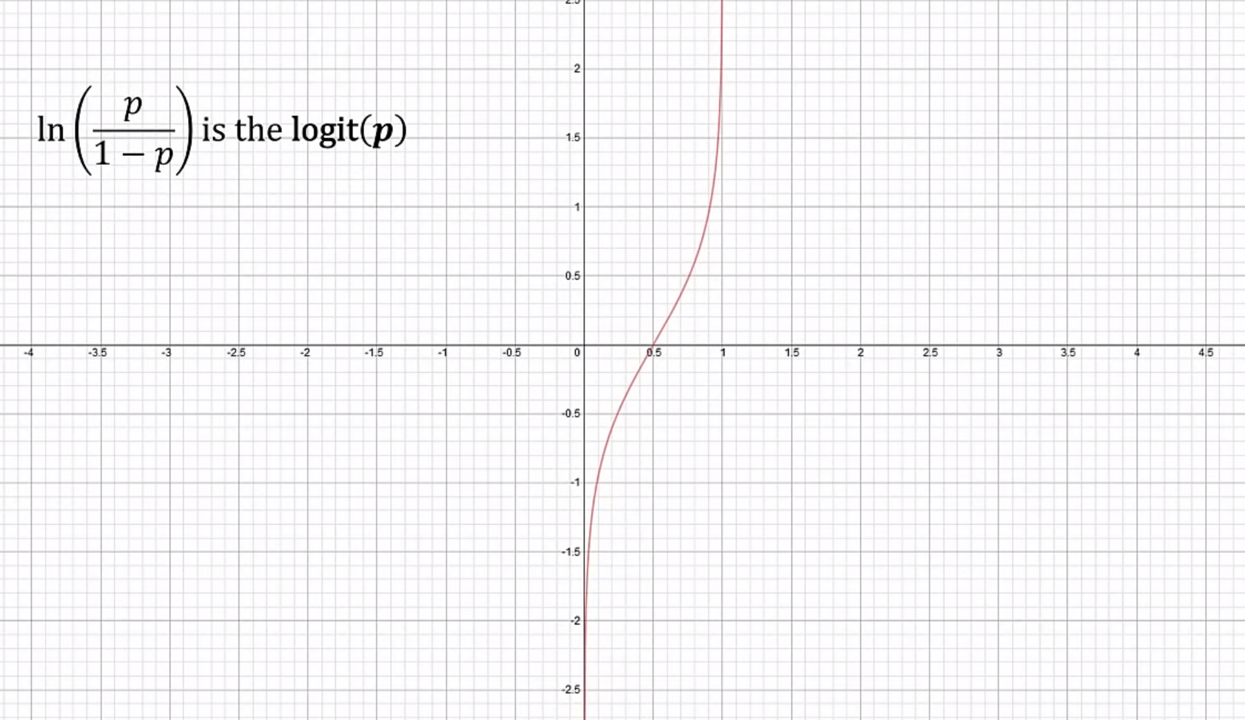

Slide 17
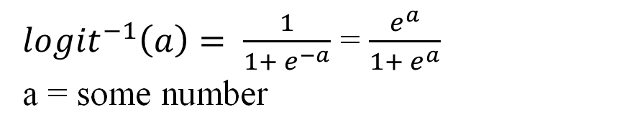
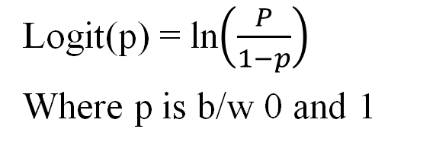
What is the Inverse Logit?
In our logit link function graph, 0 or 1 ran along the x-axis but we want the probabilities to be on the y-axis. We can achieve that by taking the inverse of the logit function
Logit(p) = ln$\left(\frac{P}{1−p}\right)$
Where p is b/w 0 and 1
${logit}^{−1}\left(a\right)= \frac{1}{1+ e^{−a}}$ = $\frac{e^{a}}{1+ e^{a}}$
a = some number

Slide 18
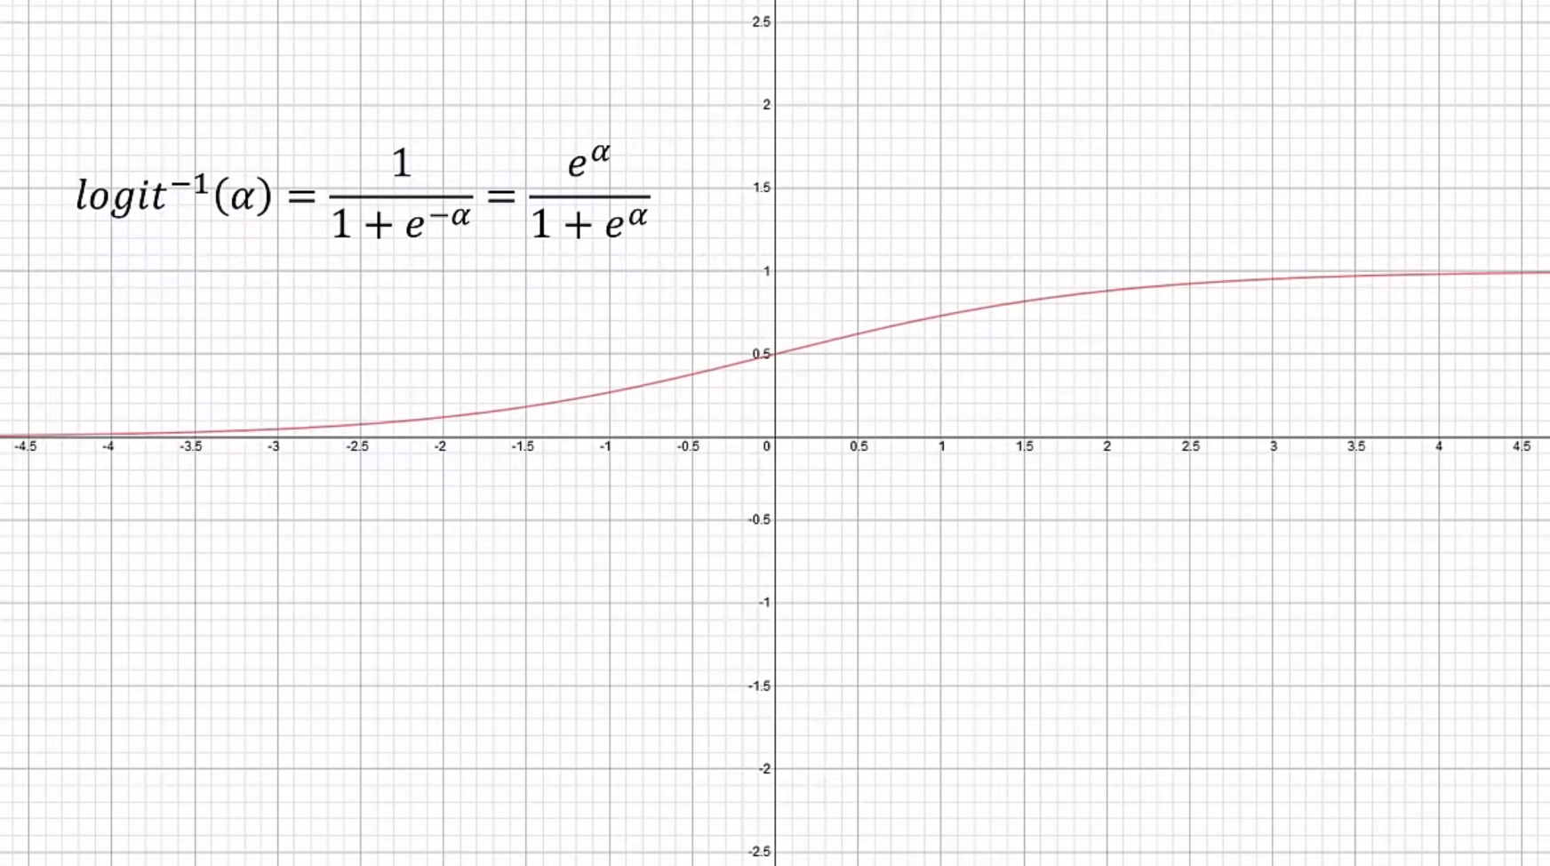

Slide 19
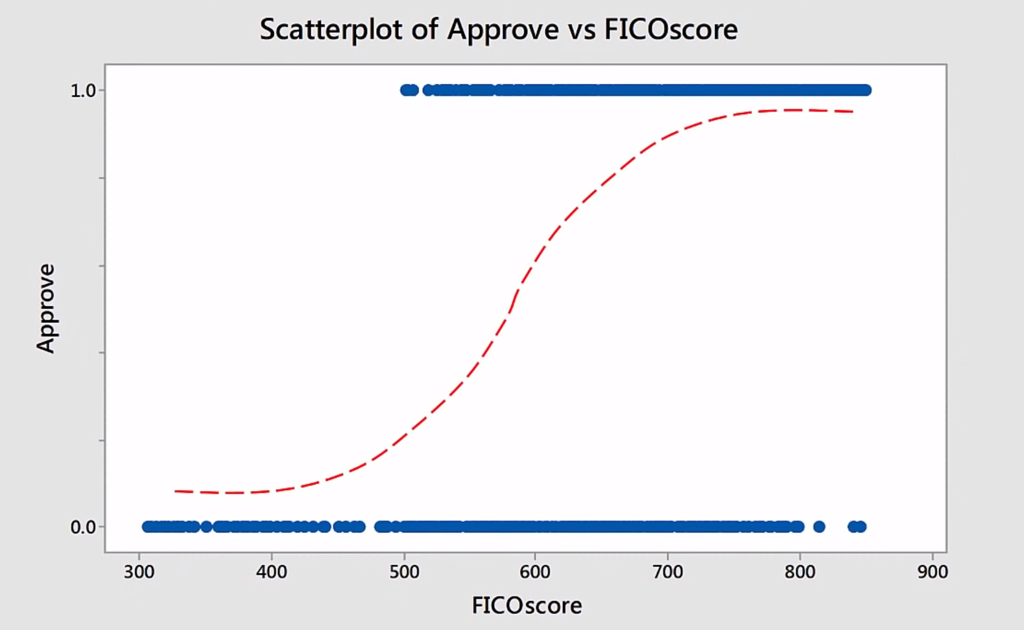

Slide 20
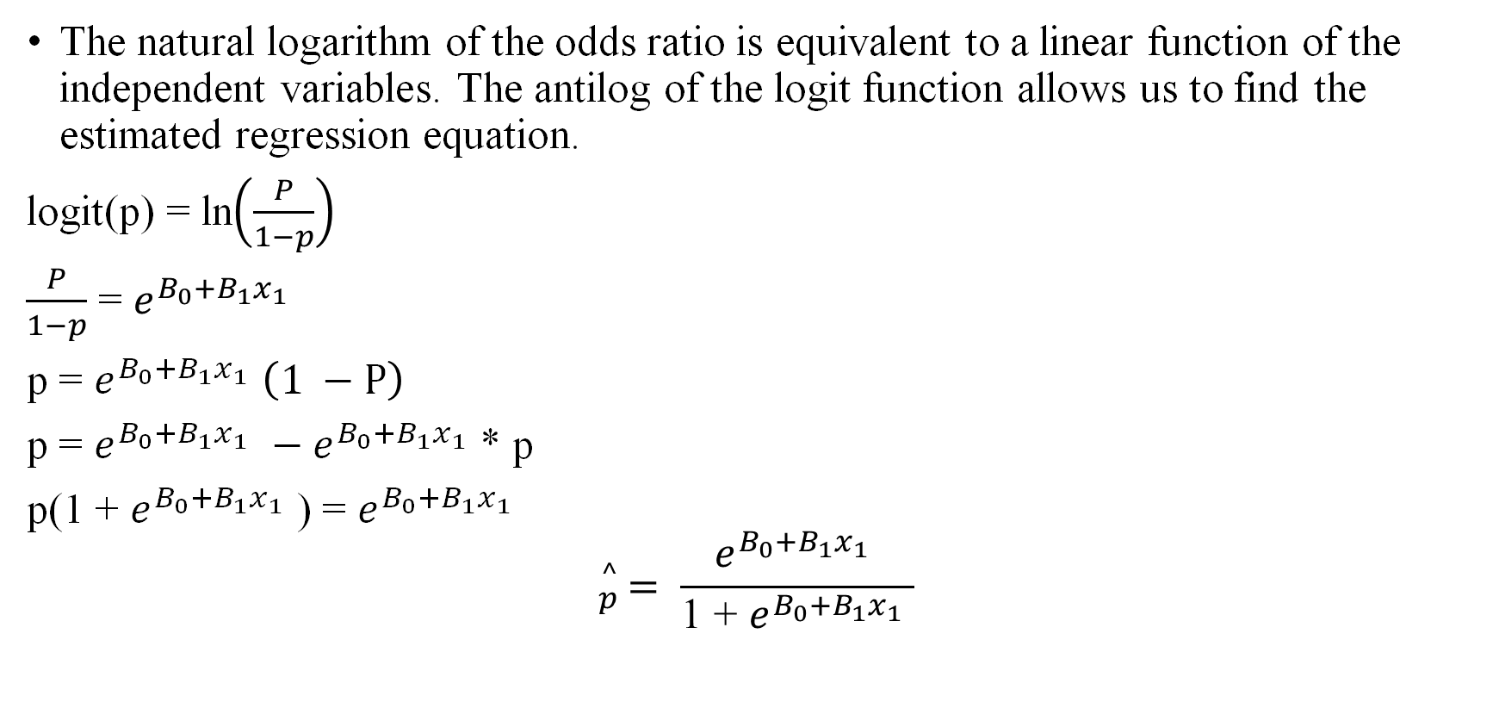
Estimated Regression Equation
The natural logarithm of the odds ratio is equivalent to a linear function of the independent variables. The antilog of the logit function allows us to find the estimated regression equation.
logit(p) = ln$\left(\frac{P}{1−p}\right)$
$\frac{P}{1−p}$ = $e^{B_{0}{+B_{1}x}_{1 }}$
p = $e^{B_{0}{+B_{1}x}_{1 }}\left(1 −P\right)$
p = $e^{B_{0}{+B_{1}x}_{1 }}−e^{B_{0}{+B_{1}x}_{1 }}$* p
p(1 + $e^{B_{0}{+B_{1}x}_{1 }}$) = $e^{B_{0}{+B_{1}x}_{1 }}$
$${}_{p}^{^}{ = \frac{e^{B_{0}{+B_{1}x}_{1 }}}{\text{1 + }e^{B_{0}{+B_{1}x}_{1 }}}}$$
Estimated Regression Equation

Slide 21
Model Data
creditScore | approved
655 | 0
681 | 0
663 | 1
688 | 1
693 | 1
699 | 0
699 | 1
683 | 1
698 | 0
655 | 1
703 | 0
704 | 1
745 | 1
702 | 1
n = 1000
creditScore is the applicant’s credit score
approved is coded “1” is approved and “0” is not proved (Binary).
* Only 14 of 1000 observations shown

Slide 22
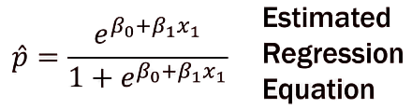
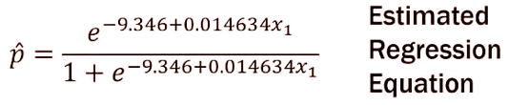

Binary Logistic Regression: Approve vs FICO Score
Coefficients value for constant and FICOscore are -9.34 and 0.014
Where ${}_{p}^{^}{ is the estimated probability of being approved and x_{1 }is a credit score}$

Slide 23
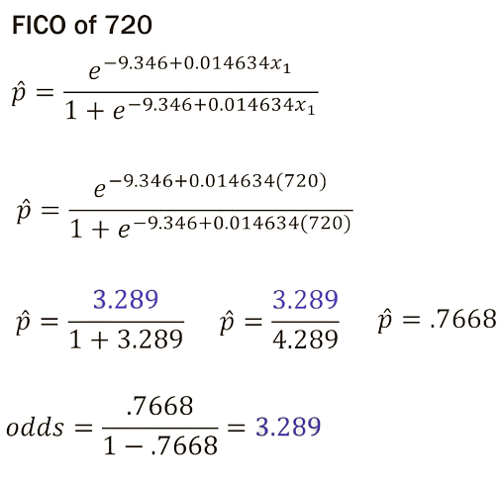
Binary Logistic Regression: Approve vs FICOscore
Remember that your score was 720, so now we can calculate the estimated probability and odds you will be approved for a mortgage based on this data and model.

Slide 24
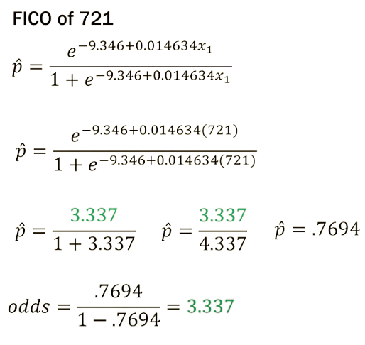

Calculate the ODDs Ratio
Odds ratio for a 1 points increase in FICO score: $\frac{3.37}{3.289}=1.0146$

Slide 25
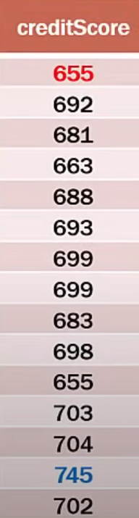
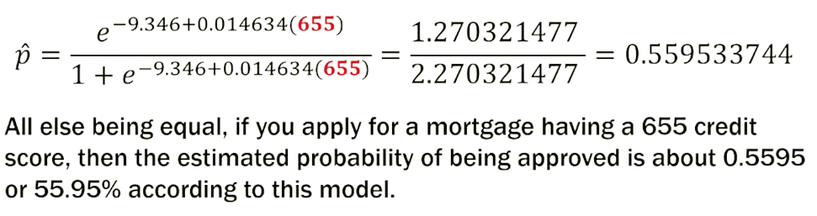
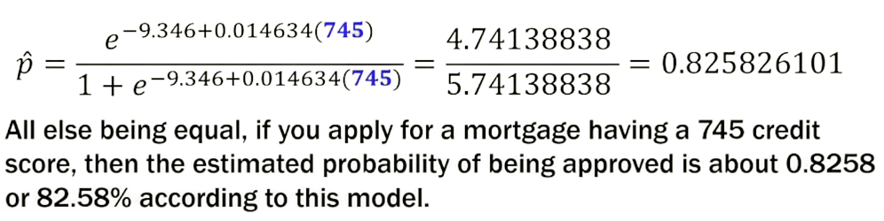
Estimated Probabilities

Slide 26
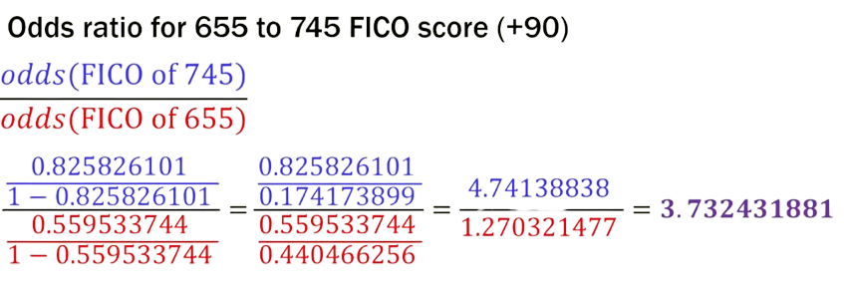
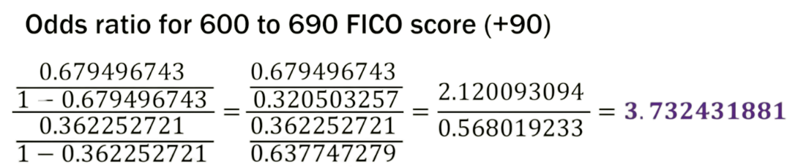
Odds Ratio for Any 90-point FICO Increase

Slide 27
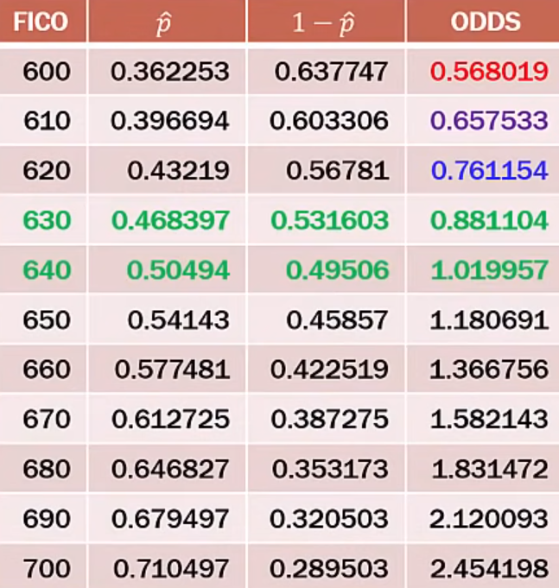
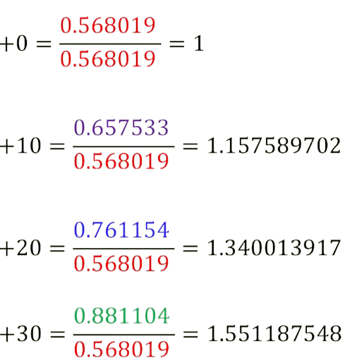
Effect of Improving FICO Score

Slide 28
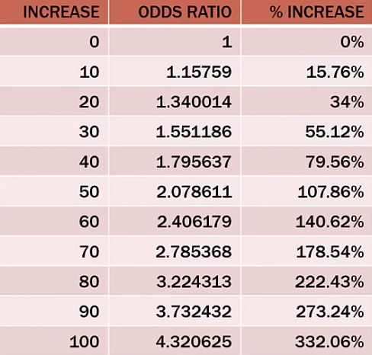
Effect of Improving FICO Score
IMPORTANT POINT:
This is the percentage increase in the odds, Not the percentage increase in the probability of being approved.

Slide 29
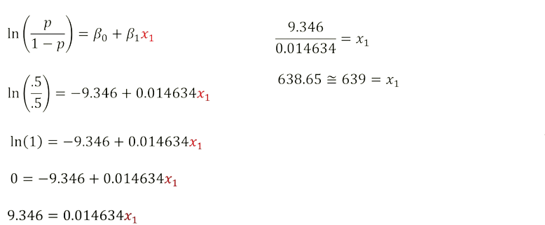
FICO FOR EVEN ODDS(50/50)
To have a 50/50 chance, or even odds for approve /disapprove, you will need to have a FICO score of approximately 639 according to this model

Slide 30
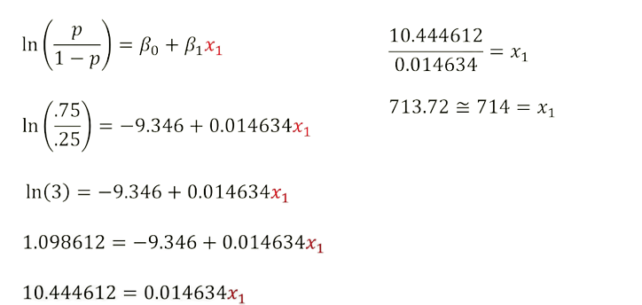
FICO FOR ODDS ODDS(.75/.25)
To have a 75% chance or 3:1 odds for approve /disapprove, you will need to have a FICO score of approximately 714 according to this model

Slide 31
Advantages and Disadvantages
Advantages
Logistic regression is easier to implement, interpret, and very efficient to train.
It is very fast at classifying unknown records.
Good accuracy for many simple data sets and it performs well when the dataset is linearly separable.
Disadvantages
If the number of observations is lesser than the number of features, Logistic Regression should not be used, otherwise, it may lead to overfitting.
Non-linear problems can’t be solved with logistic regression because it has a linear decision surface.

Slide 32
Reference
[1] Wright, R. E. (1995). Logistic regression. In L. G. Grimm & P. R. Yarnold (Eds.), Reading and understanding multivariate statistics (pp. 217–244). American Psychological Association
[2] Hosmer DW, Lemeshow S. Applied Logistic Regression. 2nd ed. New York, NY: John Wiley & Sons, Inc; 2000.
[3] Nick, T.G., Campbell, K.M. (2007). Logistic Regression. In: Ambrosius, W.T. (eds) Topics in Biostatistics. Methods in Molecular Biology™, vol 404. Humana Press. https://doi.org/10.1007/978-1-59745-530-5_14
[3] Amir A. Zain A. A Deep Level Understanding of Logistic Regression,
Wavy AI Research Foundation, Pakistan, 2019

Slide 33
?

Slide 34
Thank You☺

